Slide 1
CMSC 671
Fall 2003
Class #10– Wednesday, October 1

Slide 2
Knowledge-Based Agents
Chapter 7.1-7.3
Some material adopted from notes by Andreas Geyer-Schulz
and Chuck Dyer

Slide 3
A knowledge-based agent
A knowledge-based agent includes a knowledge base and an inference system.
A knowledge base is a set of representations of facts of the world.
Each individual representation is called a sentence.
The sentences are expressed in a knowledge representation language.
The agent operates as follows:
  1. It TELLs the knowledge base what it perceives.
  2. It ASKs the knowledge base what action it should perform.
  3. It performs the chosen action.

Slide 4
Architecture of a knowledge-based agent
Knowledge Level.
  The most abstract level: describe agent by saying what it knows.
  Example: A taxi agent might know that the Golden Gate Bridge connects San Francisco with the Marin County.
Logical Level.
  The level at which the knowledge is encoded into sentences.
  Example: Links(GoldenGateBridge, SanFrancisco, MarinCounty).
Implementation Level.
  The physical representation of the sentences in the logical level.
  Example: ‘(links goldengatebridge sanfrancisco marincounty)

Slide 5
The Wumpus World environment
The Wumpus computer game
The agent explores a cave consisting of rooms connected by passageways.
Lurking somewhere in the cave is the Wumpus, a beast that eats any agent that enters its room.
Some rooms contain bottomless pits that trap any agent that wanders into the room.
Occasionally, there is a heap of gold in a room.
The goal is to collect the gold and exit the world without being eaten

Slide 6
Jargon file on “Hunt the Wumpus”
WUMPUS /wuhm'p*s/ n. The central monster (and, in many versions, the name) of a famous family of very early computer games called “Hunt The Wumpus,” dating back at least to 1972 (several years before ADVENT) on the Dartmouth Time-Sharing System. The wumpus lived somewhere in a cave with the topology of a dodecahedron's edge/vertex graph (later versions supported other topologies, including an icosahedron and Mobius strip). The player started somewhere at random in the cave with five “crooked arrows”; these could be shot through up to three connected rooms, and would kill the wumpus on a hit (later versions introduced the wounded wumpus, which got very angry). Unfortunately for players, the movement necessary to map the maze was made hazardous not merely by the wumpus (which would eat you if you stepped on him) but also by bottomless pits and colonies of super bats that would pick you up and drop you at a random location (later versions added “anaerobic termites” that ate arrows, bat migrations, and earthquakes that randomly changed pit locations).
This game appears to have been the first to use a non-random graph-structured map (as opposed to a rectangular grid like the even older Star Trek games). In this respect, as in the dungeon-like setting and its terse, amusing messages, it prefigured ADVENT and Zork and was directly ancestral to both. (Zork acknowledged this heritage by including a super-bat colony.) Today, a port is distributed with SunOS and as freeware for the Mac. A C emulation of the original Basic game is in circulation as freeware on the net.

Slide 7
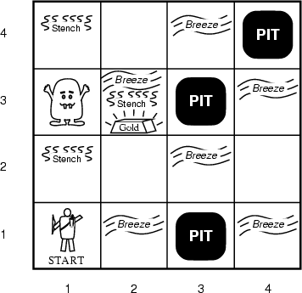
A typical Wumpus world
The agent always starts in the field [1,1].
The task of the agent is to find the gold, return to the field [1,1] and climb out of the cave.

Slide 8
Agent in a Wumpus world: Percepts
The agent perceives
  a stench in the square containing the wumpus and in the adjacent squares (not diagonally)
  a breeze in the squares adjacent to a pit
  a glitter in the square where the gold is
  a bump, if it walks into a wall
  a woeful scream everywhere in the cave, if the wumpus is killed
The percepts will be given as a five-symbol list: If there is a stench, and a breeze, but no glitter, no bump, and no scream, the percept is
  [Stench, Breeze, None, None, None]
The agent can not perceive its own location.

Slide 9
Wumpus actions
go forward
turn right 90 degrees
turn left 90 degrees
grab means pick up an object that is in the same square as the agent
shoot means fire an arrow in a straight line in the direction the agent is looking. The arrow continues until it either hits and kills the wumpus or hits the wall. The agent has only one arrow. Only the first shot has any effect.
climb is used to leave the cave. Only effective in start field.
die, if the agent enters a square with a pit or a live wumpus. (No take-backs!)

Slide 10
Wumpus goal
The agent’s goal is to find the gold and bring it back to the start as quickly as possible, without getting killed.
  1000 points reward for climbing out of the cave with the gold
  1 point deducted for every action taken
  10000 points penalty for getting killed

Slide 11
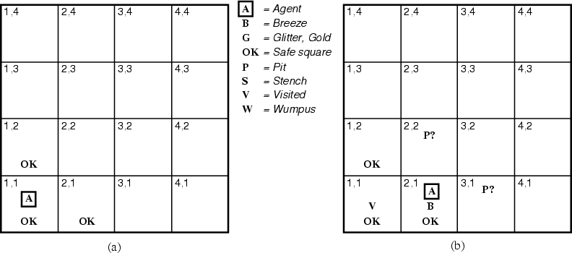
The Wumpus agent’s first step

Slide 12
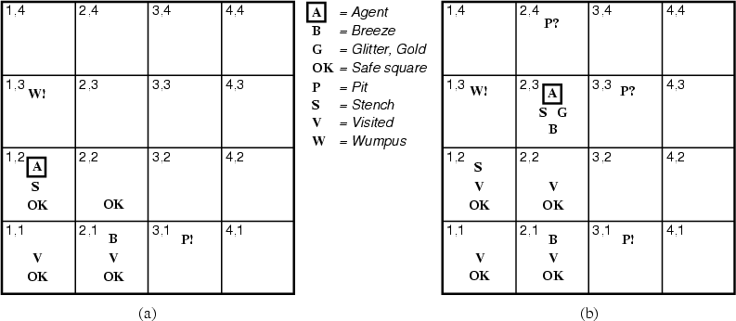
Later

Slide 13
World-wide web wumpuses
http://www.cs.berkeley.edu/~russell/code/doc/overview-AGENTS.html – Lisp version from Russell & Norvig
http://scv.bu.edu/htbin/wcl –
Web-based version you can play
http://codenautics.com/wumpus/ –
downloadable Mac version

Slide 14
Representation, reasoning, and logic
The object of knowledge representation is to express knowledge in a computer-tractable form, so that agents can perform well.
A knowledge representation language is defined by:
  its syntax, which defines all possible sequences of symbols that constitute sentences of the language.
    Examples: Sentences in a book, bit patterns in computer memory.
  its semantics, which determines the facts in the world to which the sentences refer.
    Each sentence makes a claim about the world.
    An agent is said to believe a sentence about the world.

Slide 15
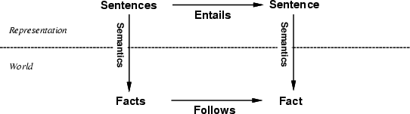
The connection between sentences and facts
Semantics maps sentences in logic to facts in the world.
The property of one fact following from another is mirrored
by the property of one sentence being entailed by another.

Slide 16
Soundness and completeness
A sound inference method derives only entailed sentences.
Analogous to the property of completeness in search, a complete inference method can derive any sentence that is entailed.

Slide 17
Logic as a KR language
Multi-valued
Logic
Modal
Temporal
Non-monotonic
Logic
Higher Order
Probabilistic
Logic
First Order
Propositional Logic
Fuzzy
Logic

Slide 18
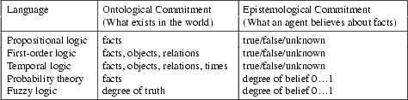
Ontology and epistemology
Ontology is the study of what there is, an inventory of what exists. An ontological commitment is a commitment to an existence claim.
Epistemology is major branch of philosophy that concerns the forms, nature, and preconditions of knowledge.

Slide 19
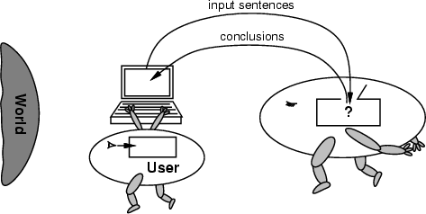
No independent access to the world
The reasoning agent often gets its knowledge about the facts of the world as a sequence of logical sentences and must draw conclusions only from them without independent access to the world.
Thus it is very important that the agent’s reasoning is sound!

Slide 20
Summary
Intelligent agents need knowledge about the world for making good decisions.
The knowledge of an agent is stored in a knowledge base in the form of sentences in a knowledge representation language.
A knowledge-based agent needs a knowledge base and an inference mechanism. It operates by storing sentences in its knowledge base, inferring new sentences with the inference mechanism, and using them to deduce which actions to take.
A representation language is defined by its syntax and semantics, which specify the structure of sentences and how they relate to the facts of the world.
The interpretation of a sentence is the fact to which it refers. If this fact is part of the actual world, then the sentence is true.

